Slide 1
Human Systems

Slide 2
Human Systems
The human body consists of many interacting systems that carry out specific functions necessary for everyday living.
A system consists of two or more organs, which are functional collections of tissue
The human body contains the following systems
Cardiovascular System
Digestive System
Reproductive System
Muscular System
Respiratory System
Nervous System
Skeletal System
Urinary System
Sense Organs

Slide 3
Cardiovascular System

Slide 4
Cardiovascular System
The cardiovascular system consists of the heart, blood vessels, and approximately 5 liters of blood
Function: responsible for transporting oxygen, nutrients, hormones, and cellular waste products throughout the body
The cardiovascular system includes two parts:
The Heart:
It is only about the size of a closed fist and is a muscular pumping organ located medial to the lungs
The bottom tip of the heart, known as its apex
The top of the heart (heart’s base) connects to the great blood vessels of the body: the aorta, vena cava, pulmonary trunk, and pulmonary veins.

Slide 5
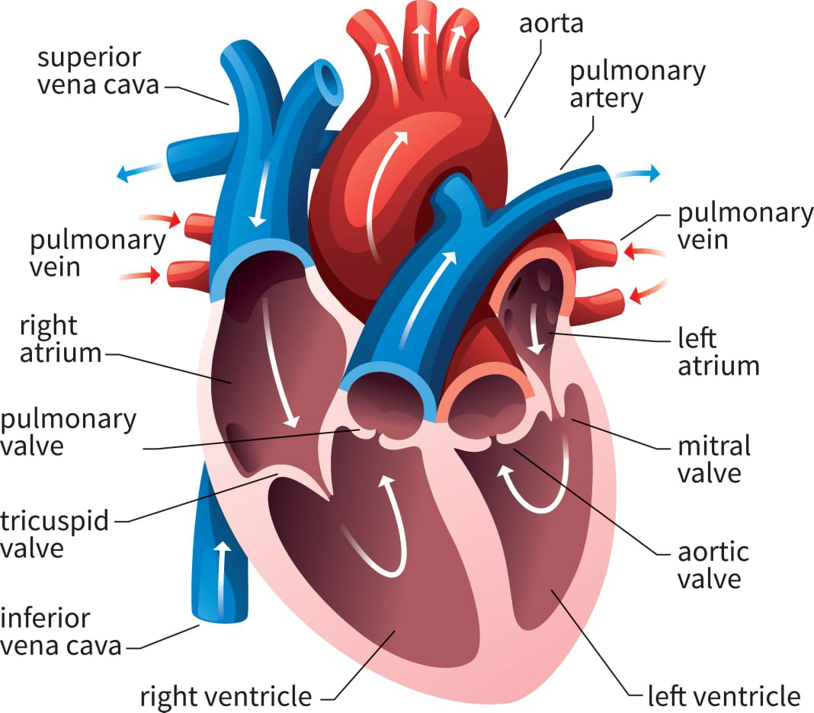
Structure of Heart

Slide 6
Blood Vessels:
Allow blood to flow quickly and efficiently from the heart to every region of the body and back again
The circulatory system is divided into two separate loops
Pulmonary circulation loop:
Transports deoxygenated blood from the right side of the heart to the lungs and oxygenated one from the lung to the heart
The pumping chambers of the heart that support the pulmonary circulation loop are the right atrium and right ventricle
Systemic circulation loop:
Carries highly oxygenated blood from the left side of the heart to all of the tissues of the body (with the exception of the heart and lungs)
Removes wastes from body tissues and returns deoxygenated blood to the right side of the heart
The left atrium and left ventricle of the heart are the pumping chambers

Slide 7
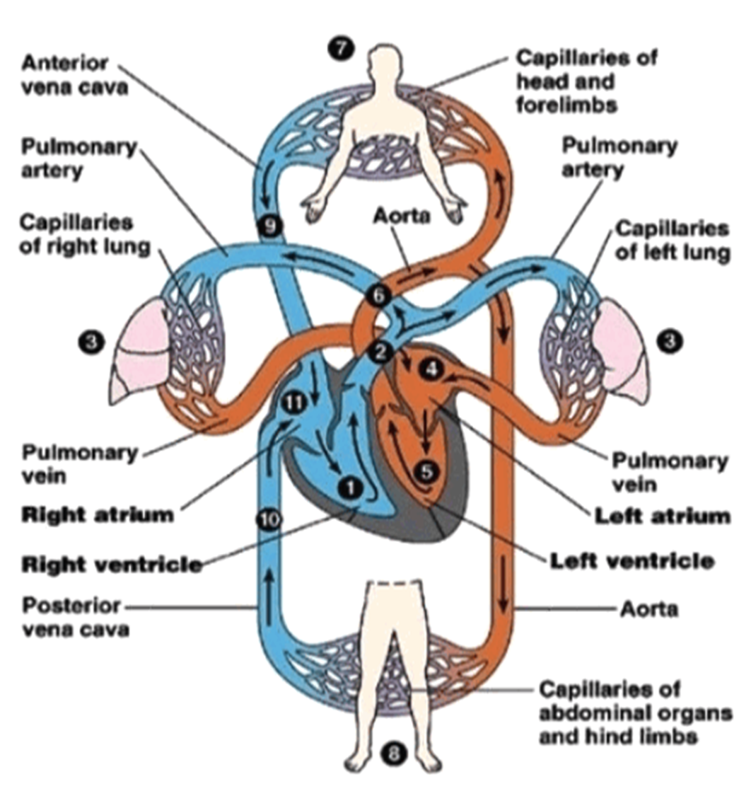

Slide 8
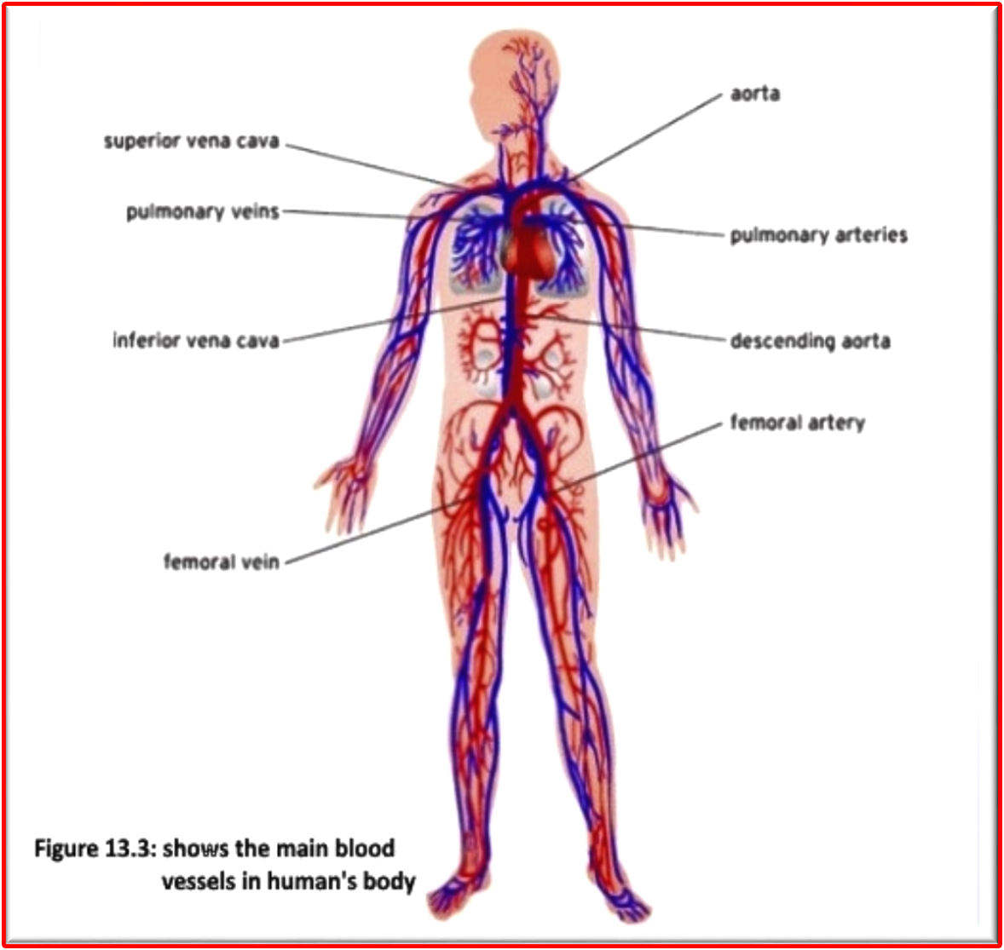

Slide 9
Digestive System

Slide 10
Digestive System
The digestive system is a group of organs working together to convert food into energy and basic nutrients to feed the entire body
Food passes through an alimentary canal or the gastrointestinal tract
The alimentary canal is made up of the oral cavity, pharynx, esophagus, stomach, small intestines, and large intestines
Accessory organs of the digestive system include the teeth, tongue, salivary glands, liver, gallbladder, and pancreas
Six major functions take place in the digestive system: Ingestion, secretion, Mixing and movement, Digestion, Absorption, Excretion

Slide 11
Parts of Digestive System
Mouth (Oral cavity):
There are many accessory organs Inside the mouth that aid in the digestion of food (the tongue, teeth, and salivary glands)
Pharynx (throat):
Responsible for the passing of masses of chewed food from the mouth to the esophagus
Esophagus:
A muscular tube connecting the pharynx to the stomach
It is part of the upper gastrointestinal tract
It carries swallowed masses of chewed food into the stomach
Stomach:
It is a muscular sac that acts as a storage tank for food
It contains hydrochloric acid and digestive enzymes that continue the digestion of food that began in the mouth

Slide 12
Duodenum
The first or proximal portion of the small intestine
It plays an important role in the digestion of food because both the common bile duct and the pancreatic duct empty into it.
Liver and Gall bladder
The main function of the liver in digestion is the production of bile and secretes into the small intestine
The gallbladder is a small, pear-shaped organ located just posterior to the liver
Used to store and recycle excess bile from the small intestine so that it can be reused for digestion.
Pancreas
The pancreas is a large gland connected to the duodenum
The pancreas secretes digestive enzymes into the small intestine to complete the chemical digestion of foods.
Small Intestine
A part of the lower gastrointestinal tract
The entire small intestine is coiled and folds to maximize the digestion of food and absorption of nutrients.
Large Intestine
The large intestine absorbs water and contains many symbiotic bacteria that aid in the breaking down of waste materials
Feces in the large intestine exit the body through the anal canal.

Slide 13
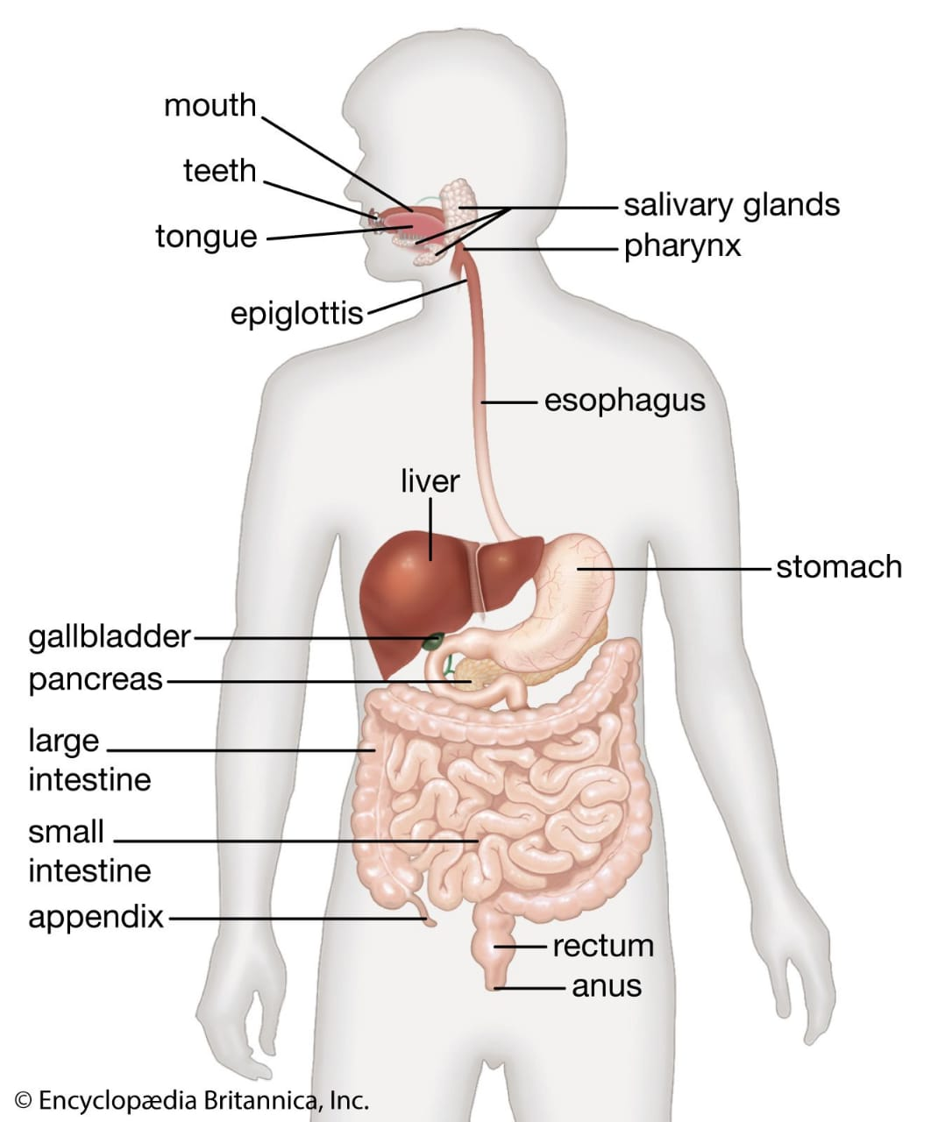

Slide 14
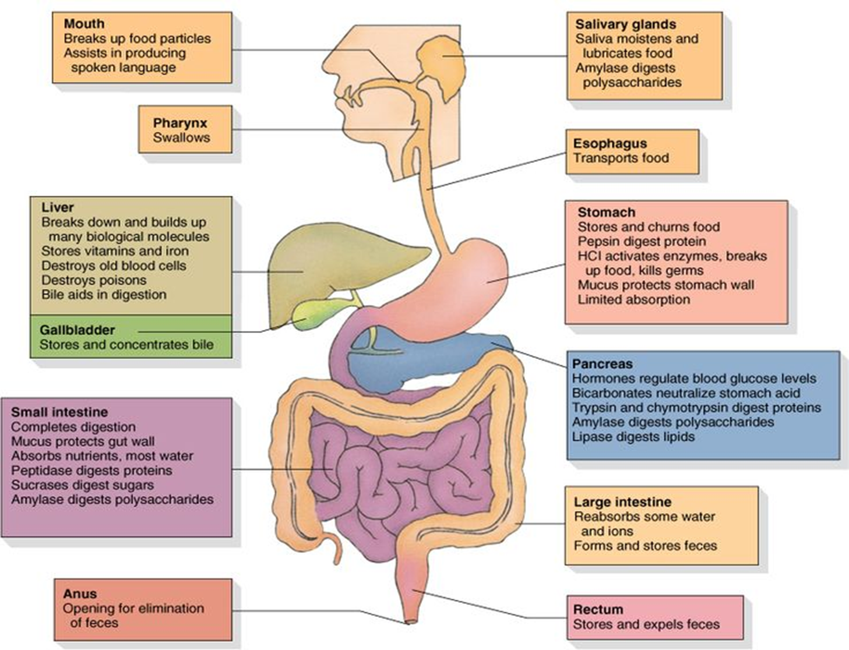

Slide 15
Reproductive System

Slide 16
Reproductive System
The reproductive system (genital system) is a collection of internal and external organs
The organs work together for the purpose of sexual reproduction
Its anatomy differs between male and female

Slide 17
1. Female Reproductive System
Its organs involved in:
Organs are involved in the production and transportation of gametes
Production of sex hormones
Facilitates the fertilization of ova by sperm
Supports the development of offspring during pregnancy and infancy
Includes the ovaries, fallopian tubes, uterus, vagina, vulva, mammary glands, and breasts

Slide 18
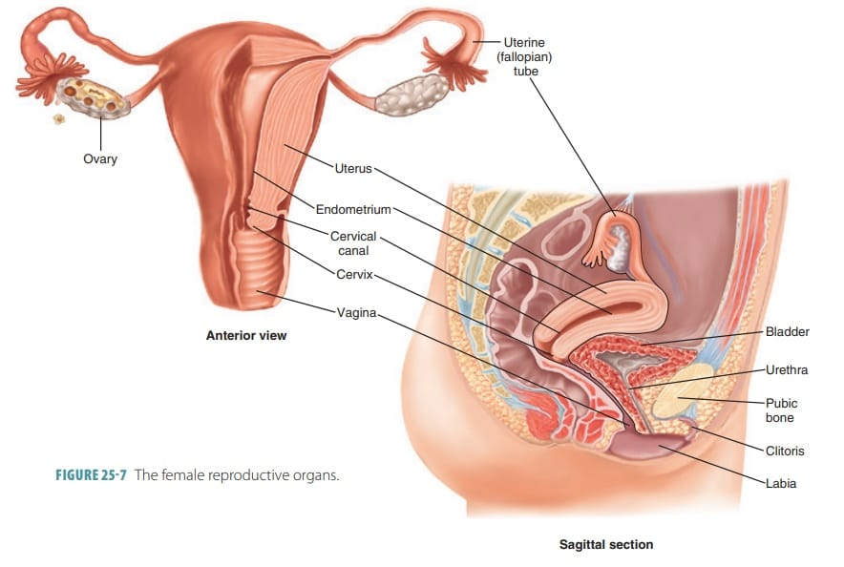

Slide 19
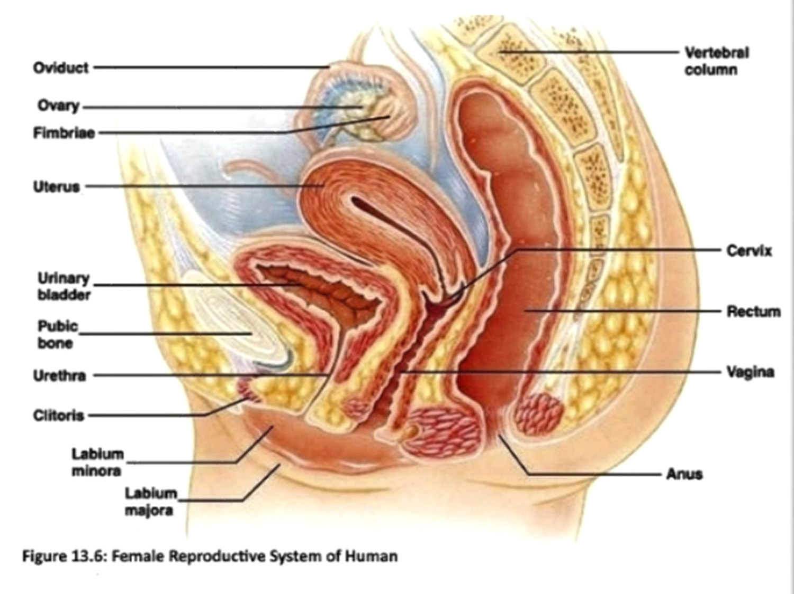

Slide 20
Ovaries
The ovaries are a pair of small glands
Ovaries produce female sex hormones such as estrogen and progesterone
Produce ova (eggs)
Fallopian Tubes:
The fallopian tubes are a pair of muscular tubes that extend from the left and right superior corners of the uterus to the edge of the ovaries
The fallopian tubes end in a funnel-shaped structure called the infundibulum which is called fimbriae
The fimbriae swipe over the outside of the ovaries to pick up released ova and carry them into the infundibulum for transport to the uterus.
Uterus
The uterus is a hollow, muscular, pear-shaped organ
Connected to the two fallopian tubes on its superior end and to the vagina (via the cervix) on its inferior end
It surrounds and supports the developing fetus during pregnancy.

Slide 21
Vagina
The vagina is an elastic, muscular tube that connects the cervix of the uterus to the exterior of the body
The vagina functions as the receptacle for the penis during sexual intercourse and carries sperm to the uterus and fallopian tubes
Vulva
The vulva surrounds the external ends of the urethral opening and the vagina and includes the mons pubis, labia majora, labia minora, and clitoris.
Breasts and Mammary Glands
The breasts are specialized organs of the female body contain mammary glands, milk ducts, and adipose tissue
In the center of each breast is a highly pigmented nipple that releases milk when stimulated
Within each breast, 15 to 20 clusters of mammary glands become active during pregnancy and remain active until milk is no longer needed.

Slide 22
2. Male Reproductive System
Includes the scrotum, testes, spermatic ducts, sex glands, and penis.
These organs work together to produce sperm (the male gamete) and other components of semen.
These organs work together to deliver semen out of the body and into the vagina where it can fertilize an egg

Slide 23
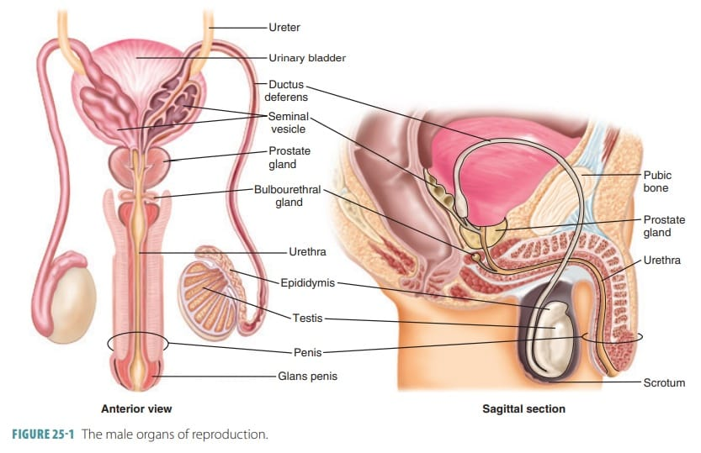

Slide 24
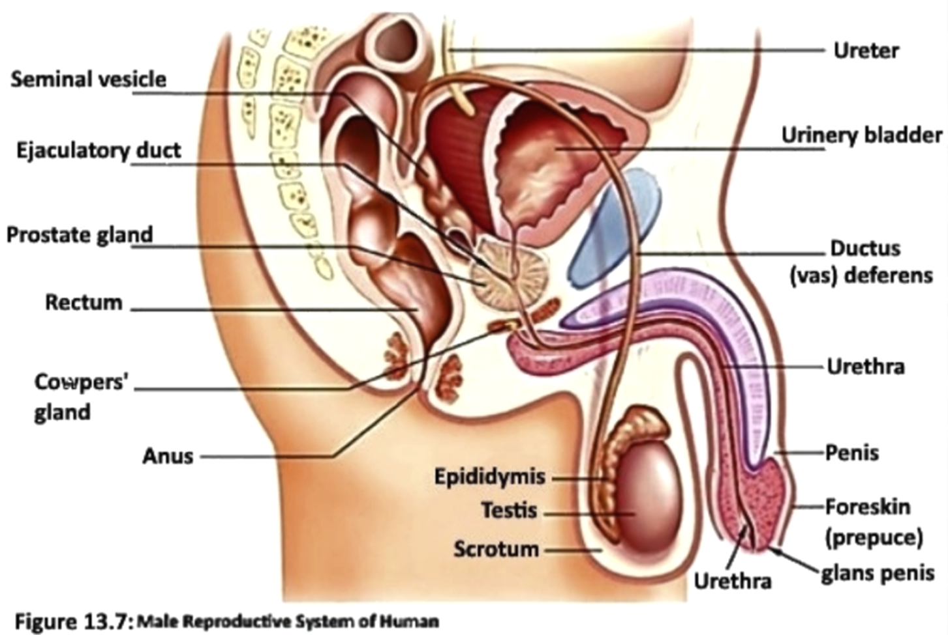

Slide 25
Scrotum
The scrotum is a sac-like organ made of skin and muscles that houses the testes
The smooth muscles that make up the scrotum allow it to regulate the distance between the testes and the rest of the body to regulate the testis's temperature.
Testes (2 testes (testicles))
Are the male gonads responsible for the production of sperm and testosterone.
Epididymis
The epididymis is a sperm maturation and storage area
The ductus deferens (vas deferens)
A muscular tube that carries sperm from the epididymis into the ejaculatory duct.
The smooth muscles of the walls of the ductus deferens are used to move sperm toward the ejaculatory duct through peristalsis
Seminal Vesicles
The seminal vesicles are a pair of exocrine glands that store and produce some of the liquid portions of semen
The liquid produced by the seminal vesicles contains proteins and mucus and has an alkaline pH to help sperm survive in the acidic environment of the vagina.
The liquid also contains fructose to feed sperm cells

Slide 26
Ejaculatory Duct
The ductus deferens passes through the prostate and joins with the urethra at a structure known as the ejaculatory duct, also, contains the ducts from the seminal vesicles
Urethra
Semen passes from the ejaculatory duct to the exterior of the body via the urethra
The urethra passes through the prostate and ends at the external urethral orifice located at the tip of the penis
Urine exiting the body from the urinary bladder also passes through the urethra.
Prostate
The prostate is exocrine gland that produces a large portion of the fluid that makes up semen.
Semen is milky white in color and contains enzymes, proteins, and other chemicals to support and protect sperm during ejaculation
Cowper’s Glands
The Cowper’s glands are a pair of exocrine glands
The Cowper’s glands secrete a thin alkaline fluid into the urethra that lubricates the urethra and neutralizes acid from urine remaining in the urethra after urination
Penis
The penis is the male external sexual organ located superior to the scrotum and inferior to the umbilicus
The penis is roughly cylindrical in shape and contains the urethra
Semen
The fluid produced by males for sexual reproduction
It contains sperm, the male reproductive gametes, along with a number of chemicals suspended in a liquid medium
The chemical composition of semen gives it a thick, sticky consistency and a slightly alkaline pH

Slide 27
Muscular System

Slide 28
Muscular System
Responsible for the movement of the human body
There are three types of muscle tissue:
Visceral Muscle:
Found inside organs like the stomach, intestines, and blood vessels
Visceral muscle makes organs contract to move substances through the organ.
Cardiac Muscle:
Found only in the heart
The cardiac muscle is responsible for pumping blood through the body.
Skeletal Muscle:
Voluntary muscle tissue in the human body
Contract to move parts of the body closer to the bone that the muscle is attached to.

Slide 29
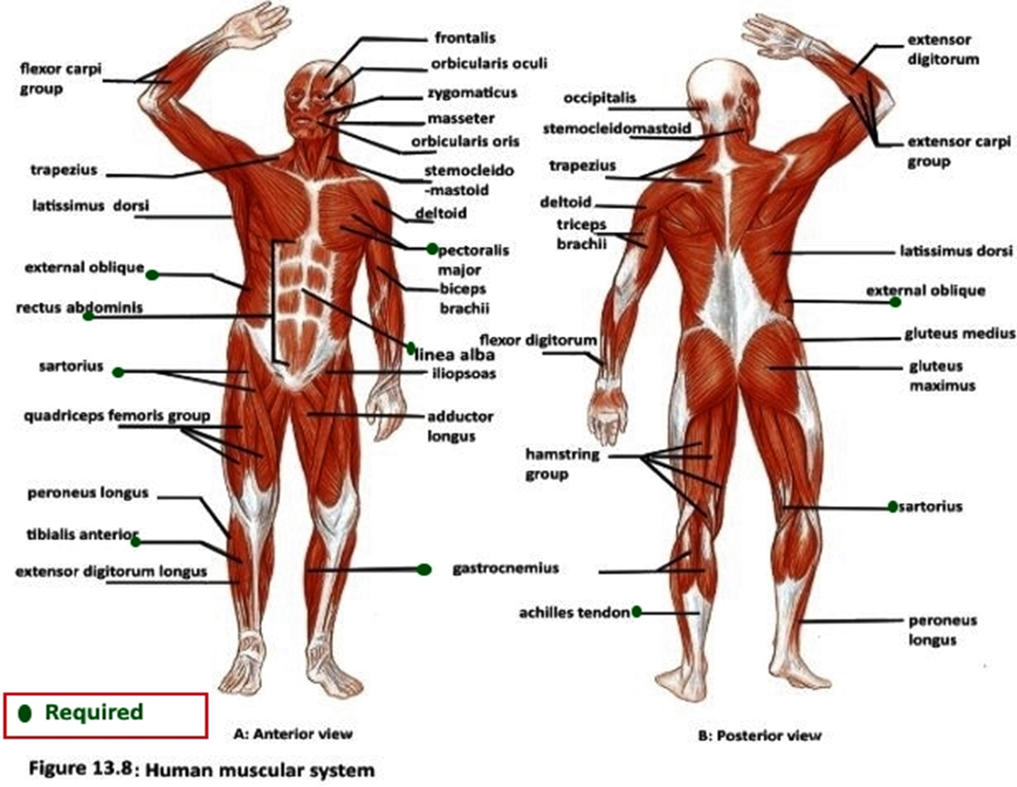

Slide 30
Respiratory System

Slide 31
Respiratory System
The respiratory system (respiratory apparatus, ventilator system) is a biological system consisting of specific organs and structures used for the process of respiration in an organism
Responsible for the exchange of oxygen and carbon dioxide between an organism and the environment
There are 3 major parts of the respiratory system:
The airways
The lungs
The muscles of respiration

Slide 32
The airways:
Carries air between the lungs and the body’s exterior.
Nose and Nasal Cavity
The main external opening for the respiratory system
Lined with hairs and mucus membrane
The function of nasal cavity is to warm, moisturize, and filter air entering the body
Mouth (Oral cavity)
Can be used to supplement or replace the nasal cavity’s functions when needed.
Pharynx (Throat)
Muscular funnel that extends from the posterior end of the nasal cavity to the superior end of the esophagus and larynx
Larynx
The larynx is located in the anterior portion of the neck
The epiglottis is one of the cartilage pieces of the larynx and acts as a switch between the trachea and the esophagus

Slide 33
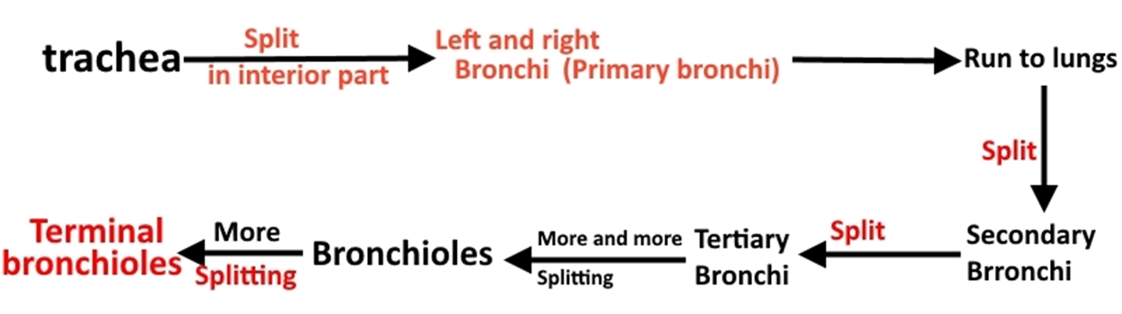
Trachea (Windpipe)
The trachea connects the larynx to the bronchi and allows air to pass through the neck and into the thorax
The main function of the trachea:
Provide a clear airway for air to enter and exit the lungs
The epithelium lining the trachea produces mucus that traps dust and other contaminants and prevents it from reaching the lungs.
Bronchi and Bronchioles
At the inferior end of the trachea, the airway splits into left and right branches are known as the primary bronchi
The main function of the bronchi and bronchioles is to carry air from the trachea into the alveoli of the lungs

Slide 34
The lungs:
The left lung is made up of 2 lobes, while the right lung has 3 lobes.
Act as the functional units of the respiratory system by
Passing oxygen into the body and carbon dioxide out of the body
The alveoli are lined with thin simple squamous epithelium that allows gases to exchange with the blood in the capillaries
The muscles of respiration
Including: sets of muscles surrounding the lungs, the diaphragm, and intercostal muscles
Work together to act as a pump, pushing air into and out of the lungs during breathing.

Slide 35
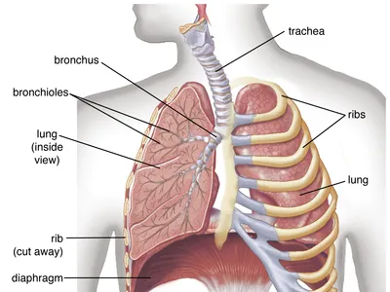

Slide 36
Nervous System

Slide 37
Nervous System
Responsible for the control of the body and communication among its parts
The nervous system consists:
The central nervous system (CNS)
The peripheral nervous system (PNS)

Slide 38
The Central Nervous System (CNS)
Evaluation and decisions
Includes: the brain and spinal cord
The brain
Protect by the skull, Cerebrospinal fluid, and meninges membrane
The brain, the seat of higher mental functions such as memory consciousness, planning, and voluntary actions, also controls lower body functions such as the maintenance of respiration, heart rate
The spinal cord
Extended in the vertebral cavity of the spine
Beginning at the medulla oblongata of the brain and continuing inferiorly to the lumbar region of the spine
The white matter: functions as the main conduit of nerve signals to the body from the brain
The grey matter: integrates reflexes into stimuli

Slide 39
The peripheral nervous system (PNS)
Bundles of axons called nerves that act as information highways to carry signals between the brain and spinal cord and the rest of the body
There are different nerves types:
Afferent Nerves: carry information from sensory receptors to the central nervous system
Efferent Nerves: carry signals only from the central nervous system to effectors such as muscles and glands.
Mixed Nerves: Afferent and efferent axons act as lanes heading toward and away from the central nervous system
Cranial Nerves: extending from the inferior side of the brain and they are 12 pairs of cranial nerves.
Spinal Nerves: Extending from the left and right sides of the spinal cord and they are 31 pairs of spinal nerves.

Slide 40
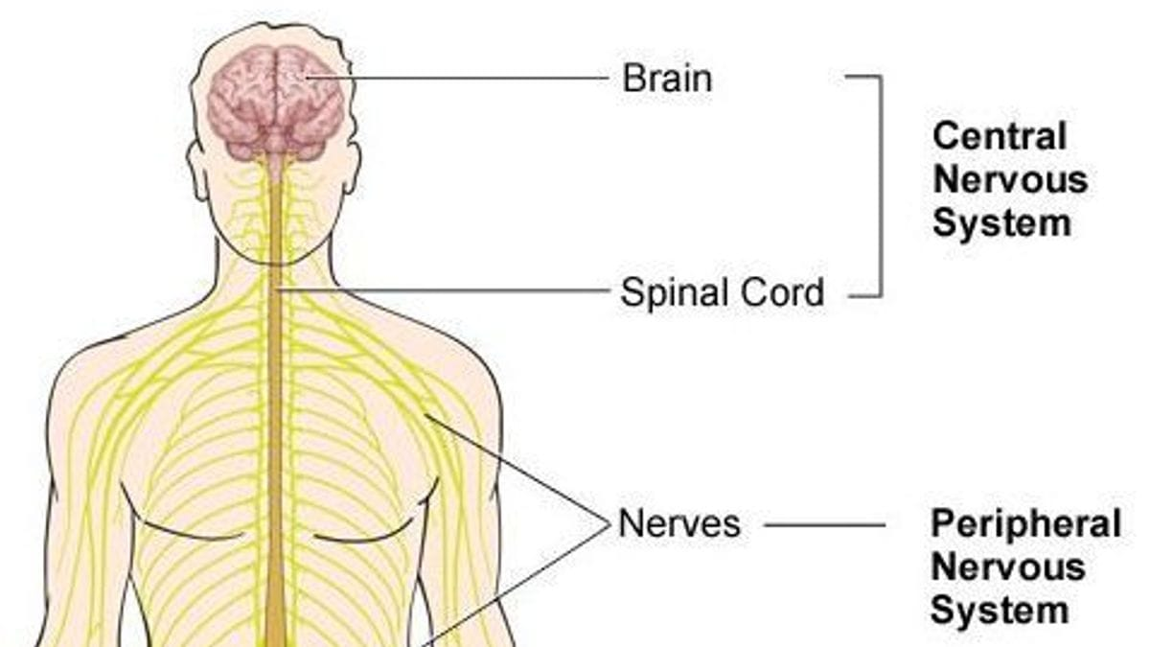

Slide 41
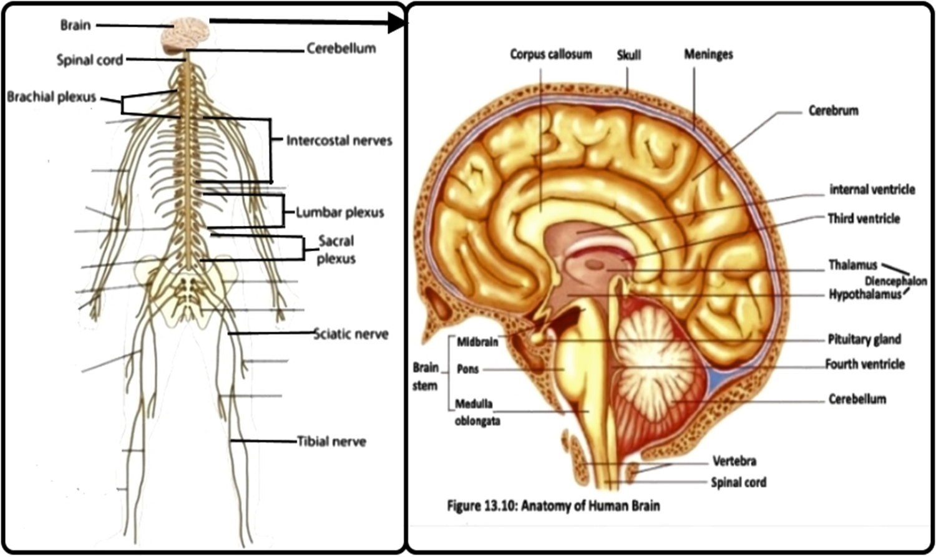

Slide 42
Skeletal System

Slide 43
Skeletal System
Includes all of the bones and joints in the body
Each bone is made up of many cells, protein fibers, and minerals.
Functions:
Provides support and protection for the soft tissues that make up the rest of the body
Provides attachment points for muscles to allow movements at the joints
New blood cells are produced by the red bone marrow inside our bones
Bones store calcium, iron, and energy

Slide 44
There are two major divisions for the skeleton:
Axial skeleton:
Runs along the body’s midline axis and includes the following regions
Skull
Hyoid
Auditory ossicles
Ribs
Sternum
Vertebral column
Appendicular skeleton: includes:
Upper limbs
Lower limbs
Pelvic girdle
Pectoral (shoulder) girdle

Slide 45
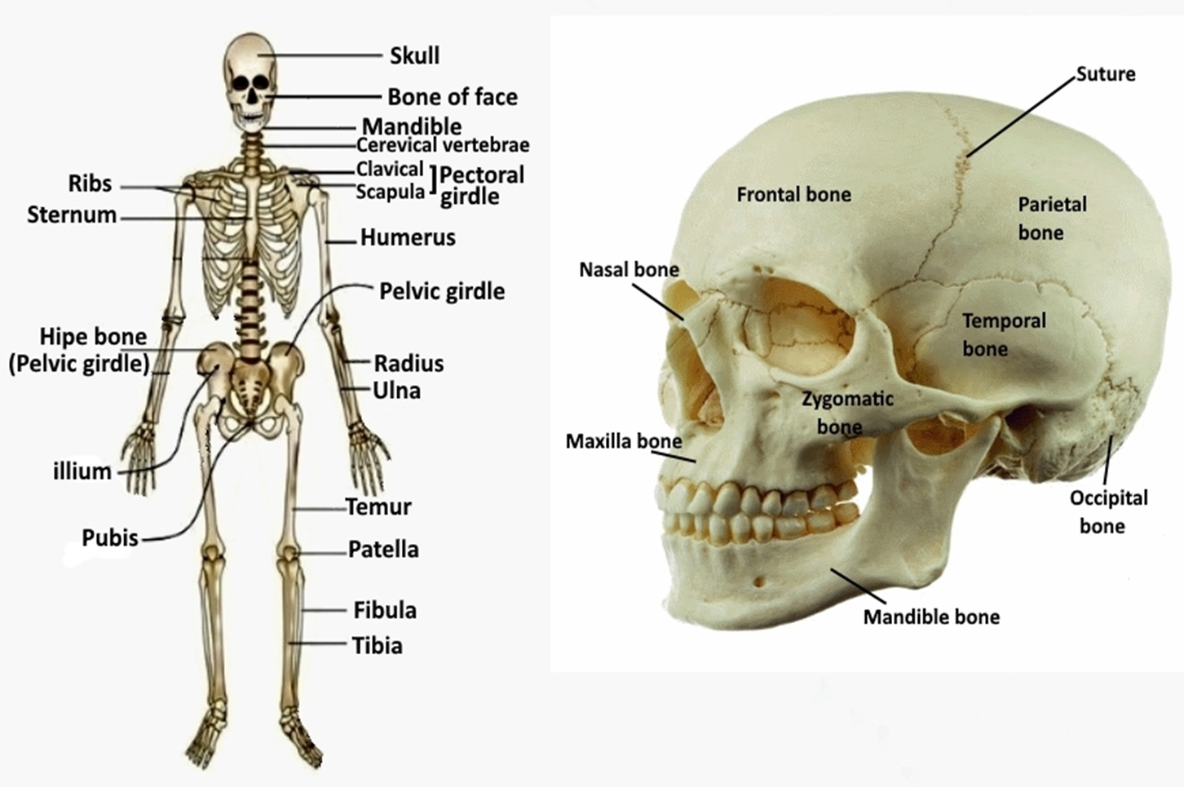

Slide 46
Urinary System

Slide 47
Urinary System
Remove wastes from the body and produces urine
Maintains the homeostasis of water, ions, pH, blood pressure, calcium, and red blood cells
The urinary system consists:
Kidneys:
The kidneys are a pair of bean-shaped organs
Filter metabolic wastes, excess ions, and chemicals from the blood to form urine
Ureters:
A pair of tubes carry urine from the kidneys to the urinary bladder
Have valves to prevent urine from flowing back toward the kidneys
Urinary bladder:
Use for the storage of urine
The walls (Transitional epithelium)of the bladder allow it to stretch to hold
Urethra:
The urethra is the tube that passes urine from the bladder to the exterior
The urethra is also an organ of the male reproductive system that carries sperm out of the body through the penis.

Slide 48
